Slide 1
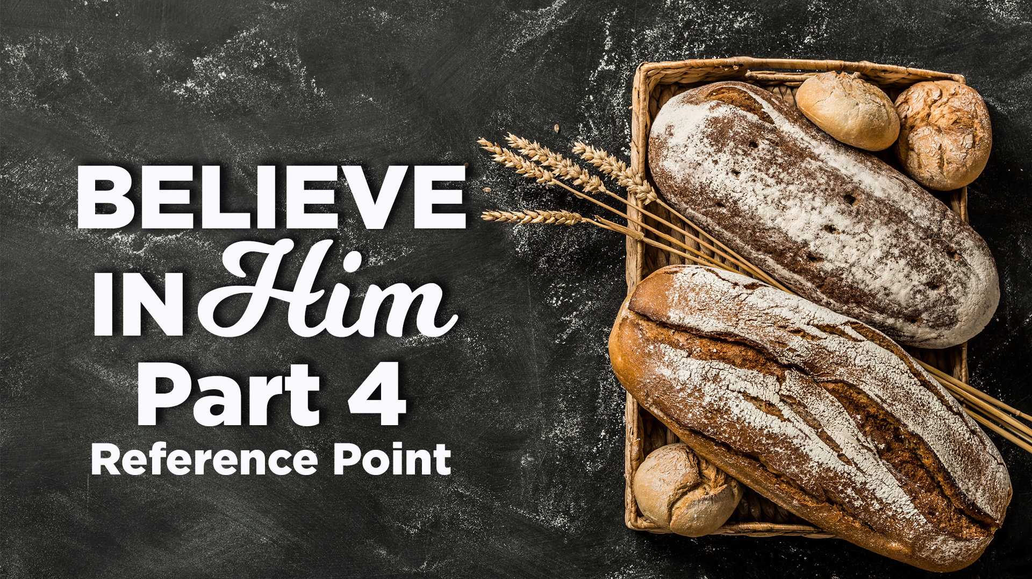

Slide 2
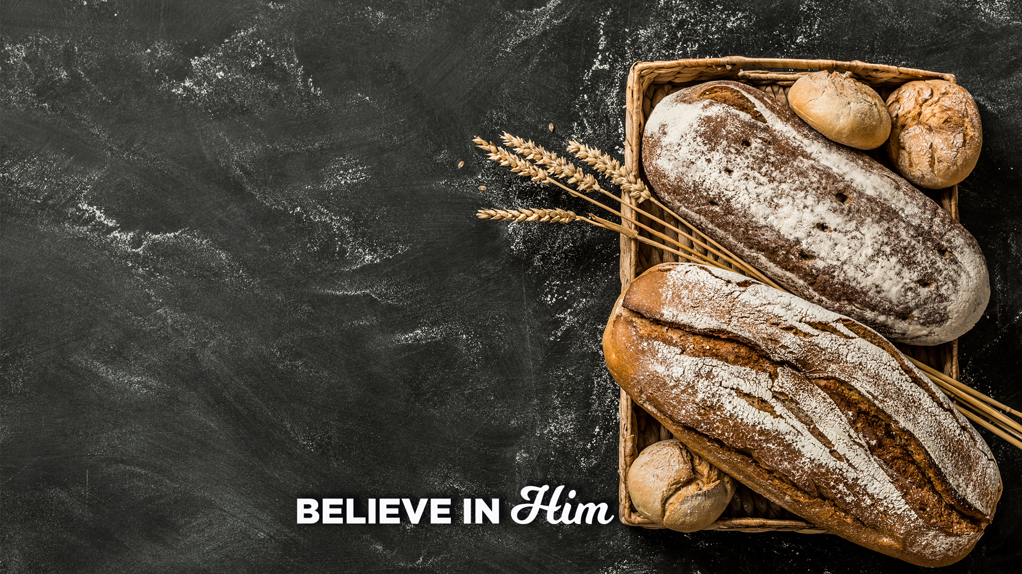
John 6:14-15
¹⁴ Therefore when the people saw the sign which He had performed, they said, “This is truly the Prophet who is to come into the world.”
¹⁵ So Jesus, perceiving that they were intending to come and take Him by force to make Him king, withdrew again to the mountain by Himself alone.

Slide 3
2 Key observations
The people have a reference point for one who is coming - the Prophet......but how accurate was THEIR REFERENCE POINT for the PROPHET!
The people are determined to make Jesus - the Prophet, king - NEX WEEK!

Slide 4
REMIND US: the Entire Context for John 6 is “Jesus is to be OUR SOURCE
KEY SCRIPTURE: This is the work of God, that you believe in Him whom He has sent

Slide 5
The Key: Their reference for what He would Do, not who He would BE (BONDSERVANT) and SAY!

Slide 6
John 4:25
The woman said to Him, “I know that Messiah is coming (He who is called Christ); when that One comes, He will declare all things to us.”

Slide 7
Point 1: Signs and Wonders are not the reference point for Jesus being the Prophet, Believing in who He is, is.

Slide 8
John 14:7-11
Oneness with the Father
⁷ If you had known Me, you would have known My Father also; from now on you know Him, and have seen Him.”
⁸ Philip said to Him, “Lord, show us the Father, and it is enough for us.”

Slide 9
John 14:7-11
⁹ Jesus said to him, “Have I been so long with you, and yet you have not
come to know Me, Philip? He who has seen Me has seen the Father; how can you say, ‘Show us the Father’? ¹⁰ Do you not believe that I am in the Father, and the Father is in Me? The words that I say to you I do not speak on My own initiative, but the Father abiding in Me does His works.

Slide 10
John 14:7-11
¹¹ Believe Me that I am in the Father and the Father is in Me; otherwise believe because of the works themselves.

Slide 11
Q: Why is this so important?
A: Because when He opens His mouth and starts to preach His Father’s Truth, everything we truly believe will be exposed for what it is - Truth or Lie.

Slide 12
Point 2: Our reference point for Jesus comes only by Revelation of the Spirit

Slide 13
John 6:45
⁴⁵ It is written in the prophets, ‘And they shall all be taught of God.’ Everyone who has heard and learned from the Father, comes to Me.

Slide 14
John 6:35-42
³⁵ Jesus said to them, “I am the bread of life; he who comes to Me will not hunger, and he who believes in Me will never thirst. ³⁶ But I said to you that you have seen Me, and yet do not believe. ³⁷ All that the Father gives Me will come to Me, and the one who comes to Me I will certainly not cast out. ³⁸ For I have come down from heaven, not to do My own will, but the will of Him who sent Me.

Slide 15
John 6:35-42
³⁹ This is the will of Him who sent Me, that of all that He has given Me I lose nothing, but raise it up on the last day. ⁴⁰ For this is the will of My Father, that everyone who beholds the Son and believes in Him will have eternal life, and I Myself will raise him up on the last day.”
⁴¹ Therefore the Jews were grumbling about Him, because He said, “I am the bread that came down out of heaven.”

Slide 16
John 6:35-42
⁴² They were saying, “Is not this Jesus, the son of Joseph, whose father and mother we know? How does He now say, ‘I have come down out of heaven’?”

Slide 17
Point 3: We can never BELIEVE in what He says, unless we have a Revelation of who He is.

Slide 18
One is ACQUIRED by man’s ability, the other is GIVEN through God’s power.

Slide 19
Galatians 1:11-12
¹¹ For I would have you know,
brethren, that the gospel which was preached by me is not according to man. ¹² For I neither received it from man, nor was I taught it, but I received it through a revelation of Jesus Christ.

