Slide 2
Connection
vs
Disconnection

Slide 3
GOAL OF GOOD COMMUNICATION
To understand each other
For heart to heart connection
To be vulnerable
To have authenticity
To build intimacy
To move towards
CONNECTION

Slide 4
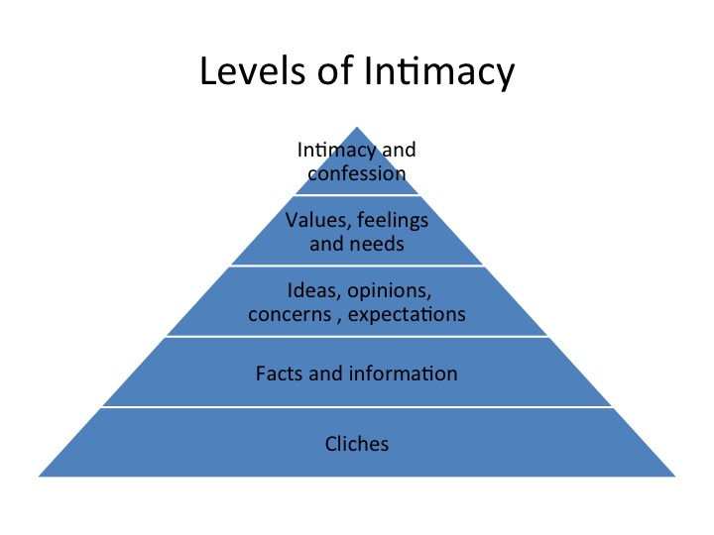

Slide 5
escalation
withdrawal
belittling
blame
WATCH OUT FOR
RELATIONAL GERMS!
false beliefs
judgement

Slide 6
Common ways of avoiding intimacy -bringing disconnection:
Reading novels
Disappearing into the garage
Camping out on the phone or facebook
Worshipping the car
Spending too much time with the kids
Volunteering for every committee
Spending too much time on the boat
Spending too much time at her mums
Avoiding eye contact
Memorizing every word of the ‘….paper’
Computer gaming
Spending hours at the gym
Falling asleep on the couch
Being a sport junkie
Coming home late for dinner
Having sex but not making love
Doing crossword puzzles
Keeping separate bank accounts
Bulimia
Jogging 10 miles a day
Going to the pub
Working on the house all the time
Refusing to talk
Avoid each other
Silent retreat to neutral corners

Slide 8
www.5lovelanguages.com

Slide 9
Personality Types
Lion
Beaver
Otter
Golden Retriever

Slide 10
POWERFUL - CHOLERIC:
Visionery
Opinionated
Decisive
Enjoys a challenge
Goal driven
Doer
Bold
DOMINANT
LION
“Let’s not waste any more time – let’s go!”

Slide 11
“Come on, trust me, it will be ok.”
PLAYFUL - SANGUINE
Enthusiastic
Outgoing
Life of the party!
Motivator
Loves FUN!
Loves variety
Loves gatherings
Engerised by people
INFLUENCER
Otter

Slide 12
PRECISE-MELANCHOLY:
Detailed
Works from lists
Tidy
Intentional
Evaluates
Persistent
Loves routine
Cautious
CONSCIENTIOUS
Beaver
“A place for everything, and everything has a place.”

Slide 13
“Don’t worry – be happy.”
PEACEFUL - PHLEGMATIC:
Loyal
Patient
Non-demanding
Dependable
Nurturing
Easy going
Calming
Supportive
STEADFAST
Golden Retriever

Slide 14
$
$
$
$
$
$
$
$

Slide 15
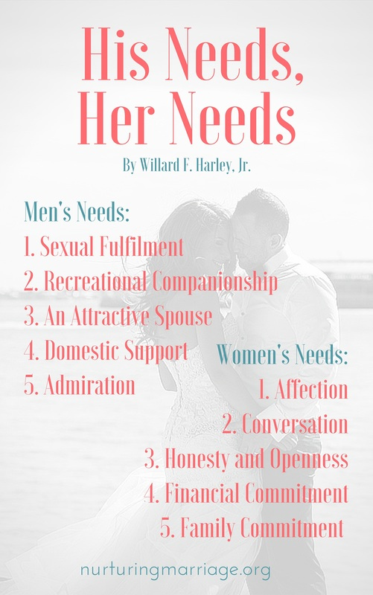

Slide 16
WHAT IS LOVE?
EROS (Romantic)
PHILEO (Friendship)
STORGE (Family)
AGAPE (Unconditional)
HASID (Covenant)

Slide 17
Top Relational Secrets:
Celebrate each others differences!
Put your love on!
Outdo each other in showing Honour!
Build Intimacy

Slide 18
Core Values and Guidelines of Healthy Communication:
Our first goal in a conversation is to understand one another.
My thoughts, feelings and needs are valuable and important, and so are yours.
I do not participate in disrespectful conversations. When my thoughts,
feelings, and needs are devalued in a conversation I will stop the conversation
and set a clear boundary. Until respect is restored I will not participate.
We need to communicate our true feelings and needs to establish trust and intimacy.
It’s my job to tell you what is going on inside me, and your job to tell me what’s going on
inside you. We do not have powers of telepathy or the right to assume we
know one another’s motives, thoughts, feelings or needs.
The best way to communicate my feelings and needs to you is to use “I messages”
and clear, specific statements that show what I am feeling and experiencing.
I will not expect you to know my feelings and needs unless I have communicated them to you.
I will not make judgment statements or tell you how you must change in order to meet my needs.
When you communicate your needs to me, it is my job to listen well
so I can understand what you need, how my life is affecting you, and what I can do to meet your needs.
I am committed to protecting and nurturing our connection. I will do
what I need to do in order to keep moving toward you – no matter what.
It is my job to manage my heart so that I can respond to you in love and
cast out fear in our relationship.

Slide 19
Crazy cycle:
The Crazy Cycle:
She Responds
Respectfully!
He Responds
Loving!

Slide 20
Cliff’s Feelings: unhappy; devalued; humiliated
Cliff’s Reactions:
withdraws; negative; defensive
Jenni’s Feelings:
disconnected;
unloved
Jenni’s Reactions:
complains;
get defensive; angry

Slide 22
Add ‘P.K’ to freshen up your marriage!
Patience
Kindness

Slide 23
Responsibility
The ability to choose a response!

Slide 24
It’s your responsibility to:
Stop blaming others
Be responsible with chores
Consistency with teaching/rearing children
Show Grace
Forgive and never hold onto hurt
Be completely open and transparent with each other
Be faithful to the vows/covenant/commitment to your partner
Close the door to divorce
Never giving up and live as un-divorced room-mates (unhappily ever after!)
Remain faithful to spouse
Build a culture of honour in your family and marriage
Making forgiveness a regular practise in your family and marriage.
Put on Love
Fulfil your God-given Role in your family

Slide 25
The Language of Apology
I am able to accept an apology from someone who expresses regret by simply saying “I am sorry”.
When I am offered an apology, I long to hear the words “I was wrong” and then acknowledges how that may of made me feel.
I find an apology most sincere when the person who has wronged me takes action to make it right.
I find an apology most sincere when followed by a promise to change, with offending person saying, “I will not do that again”.
I find an apology most sincere when the other party places great importance on asking for my forgiveness.
Learn more: Gary Chapman http://www.5lovelanguages.com/profile/apology/

Slide 26
LLUV TALK
L
LISTEN
UNDERSTAND
VALIDATE

