Slide 2
COVENANT PART 2

Slide 3
Jesus is Our Covenant Partner
1.
2.
3.
4.
5.

Slide 4
The two GREATEST TESTS that test our Covenant with God are:
The RELATIONAL TEST
2. The MISSIONAL TEST

Slide 5
Matthew 10:34-39
³⁴ “Do not think that I came to bring peace on the earth; I did not come to bring peace, but a sword. ³⁵ For I came to set a man against his father, and a daughter against her mother, and a daughter-in-law against her mother-in-law; ³⁶ and a man’s enemies will be the members of his household.

Slide 6
Matthew 10:34-39
³⁷ “He who loves father or mother more than Me is not worthy of Me; and he who loves son or daughter more than Me is not worthy of Me.

Slide 7
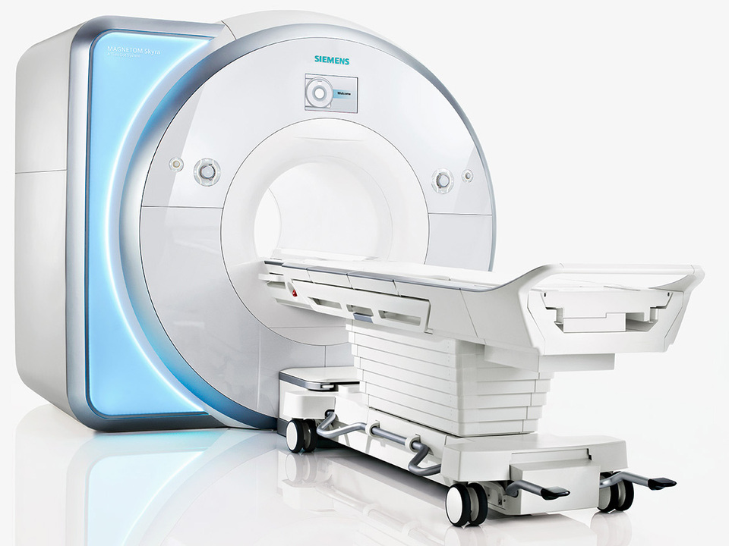

Slide 8
Matthew 10:34-39
³⁸ And he who does not take his cross and follow after Me is not worthy of Me. ³⁹ He who has found his life will lose it, and he who has lost his life for My sake will find it.

