Slide 1
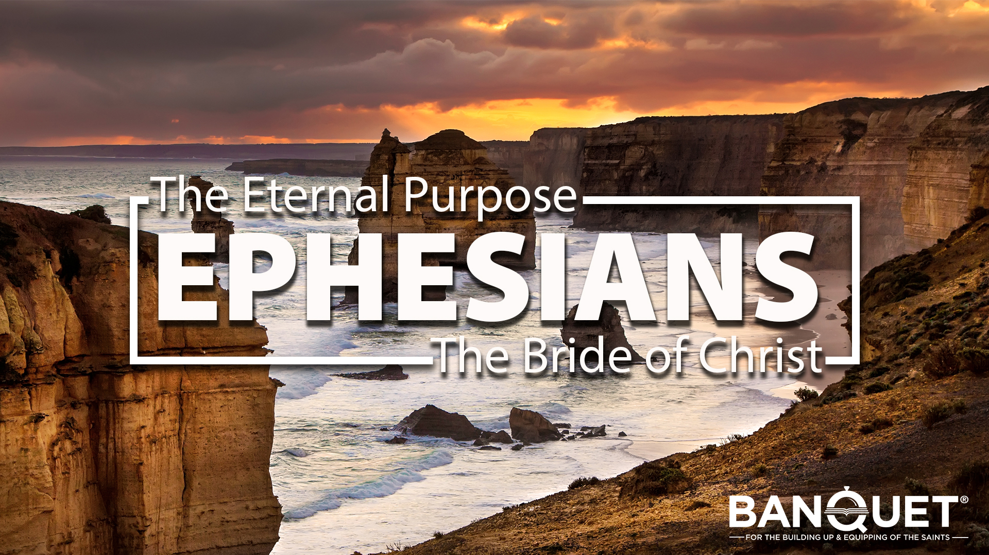

Slide 2
COVENANT

Slide 3
Revelation 1:1-3
The Revelation of Jesus Christ
¹ The Revelation of Jesus Christ, which God gave Him to show to His bond-servants, the things which must soon take place; and He sent and communicated it by His angel to His bond-servant John, ² who testified to the word of God and to the testimony of Jesus Christ, even to all that he saw. ³ Blessed is he who reads and those who hear the words of the prophecy, and heed the things which are written in it; for the time is near.

Slide 4
Revelation 1:10-11
¹⁰ I was in the Spirit on the Lord’s day, and I heard behind me a loud voice like the sound of a trumpet, ¹¹ saying, “Write in a book what you see, and send it to the seven churches: to Ephesus and to Smyrna and to Pergamum and to Thyatira and to Sardis and to Philadelphia and to Laodicea.”

Slide 5
The entire context for the scriptures is anchored and centred in a Marriage Covenant, between God and His people.

Slide 6
Definitions of Covenant
A covenant is a solemn and binding commitment between two or more parties.
A covenant is a pledge of total loyalty. In Covenant you are permanently identifying yourself with another person or people.
Covenant is a commitment that goes beyond any other commitment. It is more sacred than life itself. When you make covenant, you are literally giving your life to your covenant partner and pledging to put their needs above your own.
- Covenant is an endless partnership. It can not be broken under penalty of death.

Slide 7
God is a God of Covenant with His people.

Slide 8
Romans 9:3-5
³ For I could wish that I myself were accursed, separated from Christ for the sake of my brethren, my kinsmen according to the flesh, ⁴ who are Israelites, to whom belongs the adoption as sons, and the glory and the covenants and the giving of the Law and the temple service and the promises, ⁵ whose are the fathers, and from whom is the Christ according to the flesh, who is over all, God blessed forever. Amen.

Slide 9
Hebrews 8:7-13
A New Covenant
⁷ For if that first covenant had been faultless, there would have been no occasion sought for a second. ⁸ For finding fault with them, He says,
“Behold, days are coming, says the Lord,
When I will effect a new covenant
With the house of Israel and with the house of Judah;

Slide 10
Hebrews 8:7-13
⁹ Not like the covenant which I made with their fathers
On the day when I took them by the hand
To lead them out of the land of Egypt;
For they did not continue in My covenant,
And I did not care for them, says the Lord. ¹⁰ “For this is the covenant that I will make with the house of Israel
After those days, says the Lord:
I will put My laws into their minds,
And I will write them on their hearts.
And I will be their God,
And they shall be My people.

Slide 11
Hebrews 8:7-13
¹¹ “And they shall not teach everyone his fellow citizen,
And everyone his brother, saying, ‘Know the Lord,’
For all will know Me,
From the least to the greatest of them.
¹² “For I will be merciful to their iniquities,
And I will remember their sins no more.”
¹³ When He said, “A new covenant,” He has made the first obsolete. But whatever is becoming obsolete and growing old is ready to disappear.

Slide 12
A GREAT PICTURE OF COVENANT IS DAVID AND JONATHON

Slide 13
1 Samuel 18:1-4
Jonathan and David
¹ Now it came about when he had finished speaking to Saul, that the soul of Jonathan was knit to the soul of David, and Jonathan loved him as himself. ² Saul took him that day and did not let him return to his father’s house. ³ Then Jonathan made a covenant with David because he loved him as himself. ⁴ Jonathan stripped himself of the robe that was on him and gave it to David, with his armor, including his sword and his bow and his belt.

Slide 14
The first aspect of Covenant is: Counting the cost.

Slide 15
1 Samuel 18:3-4
³ Then Jonathan made a covenant with David because he loved him as himself. ⁴ Jonathan stripped himself of the robe that was on him and gave it to David, with his armor, including his sword and his bow and his belt.

Slide 16
2. The second aspect of Covenant is: Covenant exchanges

Slide 17
1 Samuel 18:4
⁴ Jonathan stripped himself of the robe that was on him and gave it to David, with his armor, including his sword and his bow and his belt.

Slide 18
3 Things that Jonathon exchanged with David are massively significant.
1st exchange: His Robe

Slide 19
3 Things that Jonathon exchanged with David are massively significant.
1st exchange: His Robe – Jonathon’s robe identified him as a prince of Israel
- royalty.

Slide 20
3 Things that Jonathon exchanged with David are massively significant.
1st exchange: His Robe – Jonathon’s robe identified him as a prince of Israel
- royalty.
- David’s robe identified him as a shepherd – common.

Slide 21
3 Things that Jonathon exchanged with David are massively significant.
1st exchange: His Robe – Jonathon’s robe identified him as a prince of Israel
- royalty.
- David’s robe identified him as a shepherd – common.
- Jesus exchanged robes with us – robe of righteousness/glory, for robes of rags

Slide 22
3 Things that Jonathon exchanged with David are massively significant.
2nd exchange: His Belt

Slide 23
3 Things that Jonathon exchanged with David are massively significant.
2nd exchange: His Belt – The belt is a symbol of strength.

Slide 24
3 Things that Jonathon exchanged with David are massively significant.
2nd exchange: His Belt – The belt is a symbol of strength.
- David gives Jonathon his tattered shepherds belt, Jonathon gives David his warriors belt.

Slide 25
3 Things that Jonathon exchanged with David are massively significant.
2nd exchange: His Belt – The belt is a symbol of strength.
- David gives Jonathon his tattered shepherds belt, Jonathon gives David his warriors belt
- Jesus gives us His power/strength to live this life as we surrender our strength.

Slide 26
3 Things that Jonathon exchanged with David are massively significant.
3rd exchange: His Weapons

Slide 27
3 Things that Jonathon exchanged with David are massively significant.
3rd exchange: His Weapons – Jonathon gave David his princely sword and received David’s shepherds sling.

Slide 28
3 Things that Jonathon exchanged with David are massively significant.
3rd exchange: His Weapons – Jonathon gave David his princely sword and received David’s shepherds sling.
- This exchange symbolises and exchange of enemies. Your enemies are now my enemies. In other words “I will stand with you and enter into the battle and fight with you, beside you until death.”

Slide 29
3 Things that Jonathon exchanged with David are massively significant.
3rd exchange: His Weapons – Jonathon gave David his princely sword and received David’s shepherds sling.
- This exchange symbolises and exchange of enemies. Your enemies are now my enemies. In other words “I will stand with you and enter into the battle and fight with you, beside you until death.”
- Jesus gives us His living Word to enter the battle, and now His enemies are now ours

Slide 30
3. The third aspect of Covenant is: Cutting Covenant.

Slide 31
Covenant is a blood business.

Slide 32
4. The Fourth aspect of Covenant is: The Covenant Sign.

Slide 33
Isaiah 49:15-16
¹⁵ “Can a woman forget her nursing child
And have no compassion on the son of her womb?
Even these may forget, but I will not forget you.
¹⁶ “Behold, I have inscribed you on the palms of My hands;
Your walls are continually before Me.

Slide 34
5. The fifth aspect of Covenant is: The Covenant Meal

Slide 35
Luke 22:14-20
The Lord’s Supper
¹⁴ When the hour had come, He reclined at the table, and the apostles with Him. ¹⁵ And He said to them, “I have earnestly desired to eat this Passover with you before I suffer; ¹⁶ for I say to you, I shall never again eat it until it is fulfilled in the kingdom of God.” ¹⁷ And when He had taken a cup and given thanks, He said, “Take this and share it among yourselves; ¹⁸ for I say to you, I will not drink of the fruit of the vine from now on until the kingdom of God comes.” ¹⁹ And when He had taken some bread and given thanks, He broke it and gave it to them, saying, “This is My body which is given for you; do this in remembrance of Me.” ²⁰ And in the same way He took the cup after they had eaten, saying, “This cup which is poured out for you is the new covenant in My blood.

Slide 36
Jesus is our Covenant Partner
He counted the cost.
He made a Covenant exchange.
He provided the Covenant sacrifice.
He bears in His body the Covenant sign.
He invites us to reaffirm Covenant at a Covenant meal.

