Slide 1
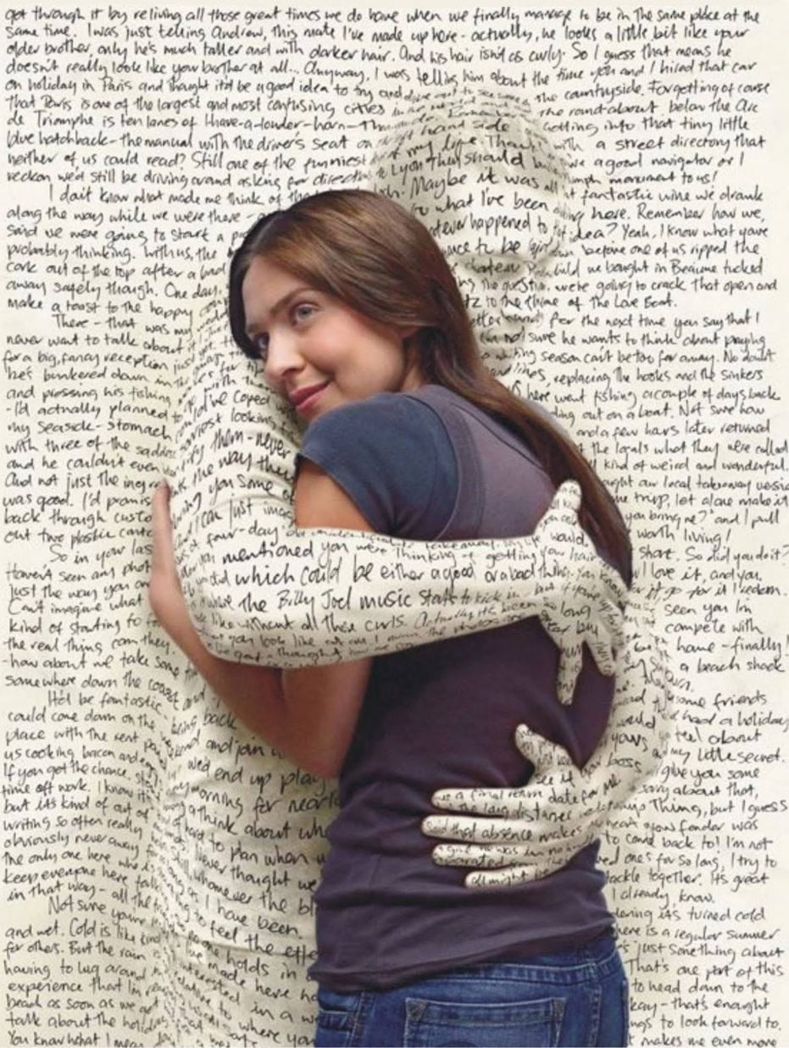

Slide 2
Transformed by The Word, not any word!

Slide 3
Amos 3:3 says Do two walk together unless they have agreed to do so

Slide 4
We as a family are desiring, asking, seeking, knocking, hoping and believing for ALL of us to come into more and more of His abundant life in us. Jesus calls us into an abundant, abounding, overflowing life in Him, in us.
Everything we are declaring, teaching, preaching, praying, being and doing is in relation to you and I coming into this Abundant Life in Christ.

Slide 5
1Thessalonians 2:13-14

Slide 6
- Receive
- the Word of God
- Hear
- Accepting
5: Performs its work in you
6: Believe

Slide 7
Q: Where does God's Word perform its work?
A : God's Word performs a work of transformation IN US
Q: What is the criteria for the Word of God to perform this work in us?
A: We must Believe His Word
Q: What do we notice about all these passages?

Slide 8
Galatians 1:13-16 For you have heard of my former manner of life in Judaism, how I used to persecute the church of God beyond measure and tried to destroy it; and I was advancing in Judaism beyond many of my contemporaries among my countrymen, being more extremely zealous for my ancestral traditions. But when God, who had set me apart even from my mother’s womb and called me through His grace, was pleased to reveal His Son in me so that I might preach Him among the Gentiles, I did not immediately consult with flesh and blood,
2 Corinthians 12:9 And He has said to me, “My grace is sufficient for you, for power is perfected in weakness.” Most gladly, therefore, I will rather boast about my weaknesses, so that the power of Christ may dwell in me.
Colossians 1:29 For this purpose also I labor, striving according to His power, which mightily works within me.
Galatians 4:19 My children, with whom I am again in labor until Christ is formed in you.
Colossians 3:16 Let the word of Christ richly dwell within you.

Slide 9
Acts 20:32 And now I commend you to God and to the word of His grace, which is able to build you up and to give you the inheritance among all those who are sanctified.

Slide 10
ALL THIS WORK IS TO BE ACCOMPLISHED "WITHIN US"

Slide 11
John 7:37-39 Now on the last day, the great day of the feast, Jesus stood and cried out, saying, “If anyone is thirsty, let him come to Me and drink. He who believes in Me, as the Scripture said, ‘From his innermost being will flow rivers of living water.’” But this He spoke of the Spirit, whom those who believed in Him were to receive; for the Spirit was not yet given, because Jesus was not yet glorified.

Slide 12
Q: What does it mean to believe?
To Believe means to have a "deep rooted conviction" of what you believe in.

Slide 13
Q: Do we carry a deep rooted conviction of this promise which has us moving towards the reality of this promise if it isn't our current reality today?

Slide 14
Mark 9:22-24

Slide 15
Hebrews 3:12-19, 4:1-16

