Slide 2
The Glory Within

Slide 3
Kavod – weight, honor
Doxa – opinion, belief
Shekinah – manifested glory (from Shakan – dwelling)

Slide 4
Exodus 33:8ff
Now Moses used to take the tent and pitch it outside the camp, a good distance from the camp, and he called it the tent of meeting. And everyone who sought the Lord would go out to the tent of meeting which was outside the camp. ⁸ And it came about, whenever Moses went out to the tent, that all the people would arise and stand, each at the entrance of his tent, and gaze after Moses until he entered the tent. ⁹ Whenever Moses entered the tent, the pillar of cloud would descend and stand at the entrance of the tent; and the Lord would speak with Moses.¹⁰ When all the people saw the pillar of cloud standing at the entrance of the tent, all the people would arise and worship, each at the entrance of his tent. ¹¹ Thus the Lord used to speak to Moses face to face, just as a man speaks to his friend. When Moses returned to the camp, his servant Joshua, the son of Nun, a young man, would not depart from the tent.

Slide 5
¹² Then Moses said to the Lord, “See, You say to me, ‘Bring up this people!’ But You Yourself have not let me know whom You will send with me. Moreover, You have said, ‘I have known you by name, and you have also found favour in My sight.’ ¹³ Now therefore, I pray You, if I have found favour in Your sight, let me know Your ways that I may know You, so that I may find favour in Your sight. Consider too, that this nation is Your people.” ¹⁴ And He said, “My presence shall go with you, and I will give you rest.” ¹⁵ Then he said to Him, “If Your presence does not go with us, do not lead us up from here. ¹⁶ For how then can it be known that I have found favour in Your sight, I and Your people? Is it not by Your going with us, so that we, I and Your people, may be distinguished from all the other people who are upon the face of the earth?”

Slide 6
¹⁷ The Lord said to Moses, “I will also do this thing of which you have spoken; for you have found favour in My sight and I have known you by name.” ¹⁸ Then Moses said, “I pray You, show me Your glory!” ¹⁹ And He said, “I Myself will make all My goodness pass before you, and will proclaim the name of the Lord before you; and I will be gracious to whom I will be gracious, and will show compassion on whom I will show compassion.” ²⁰ But He said, “You cannot see My face, for no man can see Me and live!” ²¹ Then the Lord said, “Behold, there is a place by Me, and you shall stand there on the rock; ²² and it will come about, while My glory is passing by, that I will put you in the cleft of the rock and cover you with My hand until I have passed by. ²³ Then I will take My hand away and you shall see My back, but My face shall not be seen.”

Slide 7
Now the Lord said to Moses, “Cut out for yourself two stone tablets like the former ones, and I will write on the tablets the words that were on the former tablets which you shattered. ² So be ready by morning, and come up in the morning to Mount Sinai, and present yourself there to Me on the top of the mountain. ³ No man is to come up with you, nor let any man be seen anywhere on the mountain; even the flocks and the herds may not graze in front of that mountain.” ⁴ So he cut out two stone tablets like the former ones, and Moses rose up early in the morning and went up to Mount Sinai, as the Lord had commanded him, and he took two stone tablets in his hand.

Slide 8
⁵ The Lord descended in the cloud and stood there with him as he called upon the name of the Lord.⁶ Then the Lord passed by in front of him and proclaimed, “The Lord, the Lord God, compassionate and gracious, slow to anger, and abounding in lovingkindness and truth; ⁷ who keeps lovingkindness for thousands, who forgives iniquity, transgression and sin; yet He will by no means leave the guilty unpunished, visiting the iniquity of fathers on the children and on the grandchildren to the third and fourth generations.”⁸ Moses made haste to bow low toward the earth and worship. ⁹ He said, “If now I have found favour in Your sight, O Lord, I pray, let the Lord go along in our midst, even though the people are so obstinate, and pardon our iniquity and our sin, and take us as Your own possession.”

Slide 9
God alone is Holy, Righteous, Truth, Good, and Gracious.
He is weighty and deserving of all honour
He is a consuming fire
Exodus 3:5
Then He said, “Do not come near here; remove your sandals from your feet, for the place on which you are standing is holy ground.”

Slide 10
Hebrews 1:3
And He is the radiance of His glory and the exact representation of His nature, and upholds all things by the word of His power. When He had made purification of sins, He sat down at the right hand of the Majesty on high,
John 1:14
[ The Word Made Flesh ] And the Word became flesh, and dwelt among us, and we saw His glory, glory as of the only begotten from the Father, full of grace and truth.

Slide 11
Exodus 33: 6-7
Then the Lord passed by in front of him and proclaimed, “The Lord, the Lord God, compassionate and gracious, slow to anger, and abounding in lovingkindness and truth; ⁷ who keeps lovingkindness for thousands, who forgives iniquity, transgression and sin; yet He will by no means leave the guilty unpunished, visiting the iniquity of fathers on the children and on the grandchildren to the third and fourth generations.”
God’s opinion/revelation of Himself – His nature

Slide 12
^{Mathew 3:16-17}
¹⁶ After being baptized, Jesus came up immediately from the water; and behold, the heavens were opened, and he saw the Spirit of God descending as a dove and lighting on Him, ¹⁷ and behold, a voice out of the heavens said, “This is My beloved Son, in whom I am well-pleased.”
God’s opinion/revelation of His Son and us!

Slide 13
Who do you say I AM? Who AM I to you?
Do we know who we are in Him?
Does our Theology align with our Doxology?
Who’s opinion matters? Whose glory do we seek?

Slide 14
Man fell short of the Glory of God...
- Weight (Person via Relationship)
Opinion (Word/Revelation)
Dwelling (Presence/Power)

Slide 15
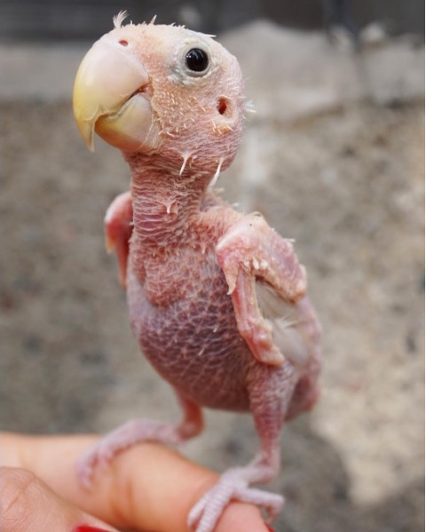

Slide 16
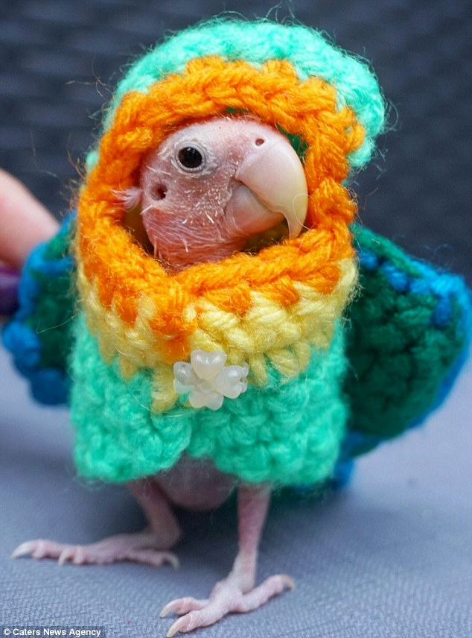
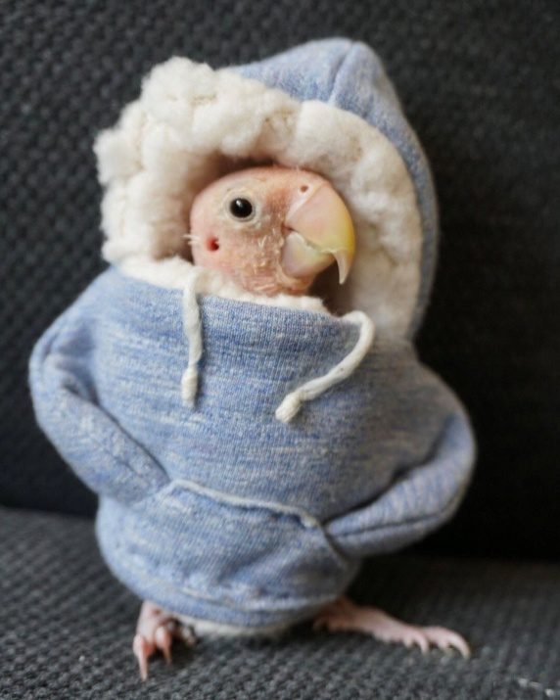
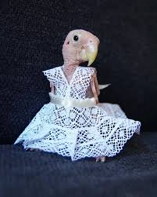
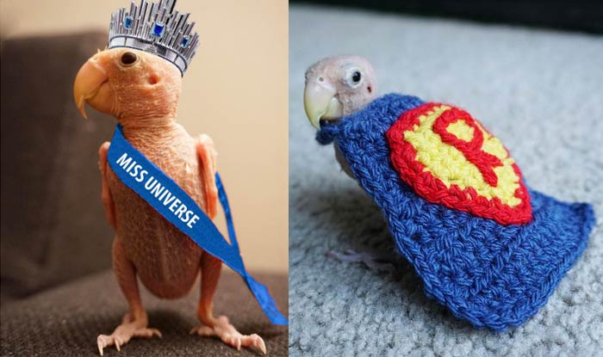

Slide 17
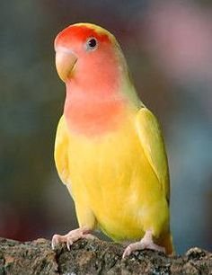
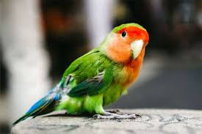

Slide 18
What are we wearing? What is our clothing?
Are we still naked? blind, deaf, and poor?
What image is on us? Do we glorify God with our clothing?
Christ in form and substance.
- our banner, our armour, our righteousness
our salvation, our wedding garment
our identity, our position, our reality

Slide 19
Hebrews 12:1-3
12 Therefore, since we are surrounded by such a great cloud of witnesses, let us throw off everything that hinders and the sin that so easily entangles. And let us run with perseverance the race marked out for us, ² fixing our eyes on Jesus, the pioneer and perfecter of faith. For the joy set before him he endured the cross, scorning its shame, and sat down at the right hand of the throne of God. ³ Consider him who endured such opposition from sinners, so that you will not grow weary and lose heart.

Slide 20
The Body Is the Lord’s
1 Corinthians 6:13-20
¹³ Food is for the stomach and the stomach is for food, but God will do away with both of them. Yet the body is not for immorality, but for the Lord, and the Lord is for the body. ¹⁴ Now God has not only raised the Lord, but will also raise us up through His power. ¹⁵ Do you not know that your bodies are members of Christ? Shall I then take away the members of Christ and make them members of a prostitute? May it never be! ¹⁶ Or do you not know that the one who joins himself to a prostitute is one body with her? For He says, “The two shall become one flesh.” ¹⁷ But the one who joins himself to the Lord is one spirit with Him. ¹⁸ Flee immorality. Every other sin that a man commits is outside the body, but the immoral man sins against his own body. ¹⁹ Or do you not know that your body is a temple of the Holy Spirit who is in you, whom you have from God, and that you are not your own? ²⁰ For you have been bought with a price: therefore glorify God in your body.

Slide 21
1 Peter 3:18
For Christ also died for sins once for all, the just for the unjust, so that He might bring us to God, having been put to death in the flesh, but made alive in the spirit;
Galatians 2:20
²⁰ I have been crucified with Christ; and it is no longer I who live, but Christ lives in me; and the life which I now live in the flesh I live by faith in the Son of God, who loved me and gave Himself up for me.

Slide 22
2 Corinthians 3:4ff
⁴ Such confidence we have through Christ toward God. ⁵ Not that we are adequate in ourselves to consider anything as coming from ourselves, but our adequacy is from God, ⁶ who also made us adequate as servants of a new covenant, not of the letter but of the Spirit; for the letter kills, but the Spirit gives life.
⁷ But if the ministry of death, in letters engraved on stones, came with glory, so that the sons of Israel could not look intently at the face of Moses because of the glory of his face, fading as it was, ⁸ how will the ministry of the Spirit fail to be even more with glory? ⁹ For if the ministry of condemnation has glory, much more does the ministry of righteousness abound in glory. ¹⁰ For indeed what had glory, in this case has no glory because of the glory that surpasses it. ¹¹ For if that which fades away was with glory, much more that which remains is in glory.

Slide 23
¹² Therefore having such a hope, we use great boldness in our speech,¹³ and are not like Moses, who used to put a veil over his face so that the sons of Israel would not look intently at the end of what was fading away. ¹⁴ But their minds were hardened; for until this very day at the reading of the old covenant the same veil remains unlifted, because it is removed in Christ. ¹⁵ But to this day whenever Moses is read, a veil lies over their heart; ¹⁶ but whenever a person turns to the Lord, the veil is taken away. ¹⁷ Now the Lord is the Spirit, and where the Spirit of the Lord is, there is liberty. ¹⁸ But we all, with unveiled face, beholding as in a mirror the glory of the Lord, are being transformed into the same image from glory to glory, just as from the Lord, the Spirit.

Slide 24
Old Contract | New Covenant
Fading | Increasingly glorious
Physical/External interaction | Spirit/Internal interaction
Resided in Temple of stone | We are the temple
Temple built by men | Church build by God
Tablets of stone | Tablets of heart
Contract (external works, form) | Covenant (fruit of Spirit, substance)
Result in death (apart from God) | Brings life (abiding in Spirit)
God left the temple | God never leaves us
See His back | Behold His face
Hidden in cleft in rock | Hidden in Christ
Form only | Form and substance

Slide 25
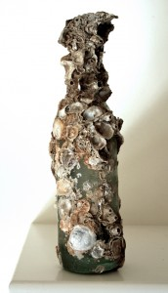
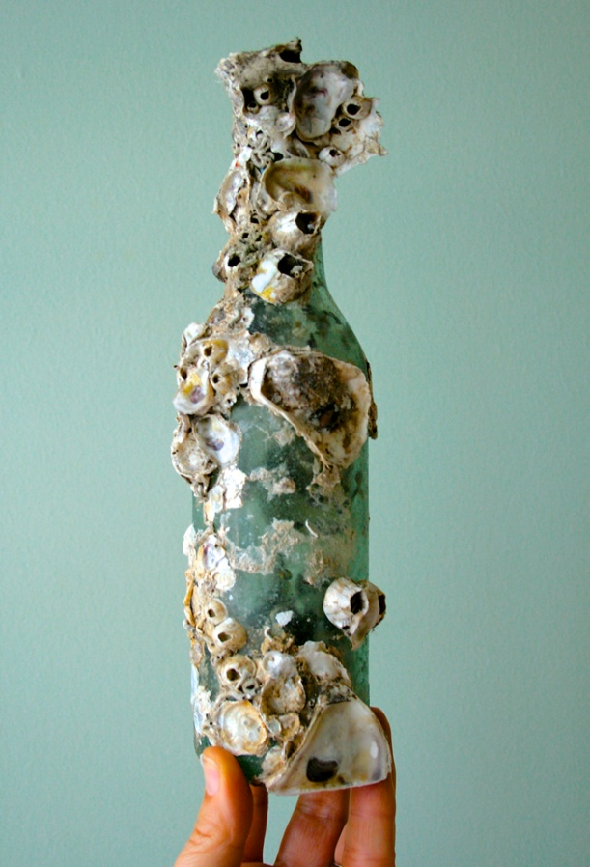
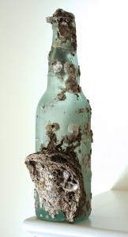
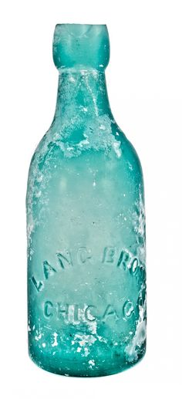

Slide 26
Ephesians 3:19
¹⁹ and to know the love of Christ which surpasses knowledge, that you may be filled up to all the fullness of God.
Habakkuk 2:14
“For the earth will be filled With the knowledge of the glory of the Lord, As the waters cover the sea.

Slide 27
Revelation 21: 2, 22
² And I saw the holy city, new Jerusalem, coming down out of heaven from God, made ready as a bride adorned for her husband. ³ And I heard a loud voice from the throne, saying, “Behold, the tabernacle of God is among men, and He will dwell among them, and they shall be His people, and God Himself will be among them,
²² I saw no temple in it, for the Lord God the Almighty and the Lamb are its temple. ²³ And the city has no need of the sun or of the moon to shine on it, for the glory of God has illumined it, and its lamp is the Lamb. ²⁴ The nations will walk by its light, and the kings of the earth will bring their glory into it.

Slide 28
Darkness, rot and despair are not our enemies.
Q: Where is light? Where is salt? Where is hope?
Spirit of God and His Word at work within us.
Christ in us is our light and hope.
Christ in the Church is the light and hope of the world. (Romans 8:19)

Slide 29
Ephesians 5:14
For this reason it says, “Awake, sleeper, And arise from the dead, And Christ will shine on you.”
Isaiah 60:1
[ A Glorified Zion ] “Arise, shine; for your light has come, And the glory of the Lord has risen upon you.
John 17

