Slide 1
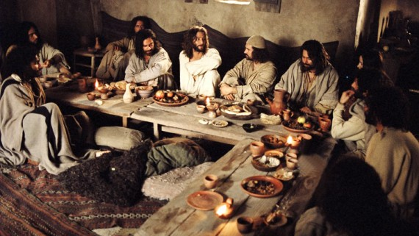
OF EATING AND DRINKING

Slide 2
Food and Life
Eat to live
Culture and community
Pleasure and drive

Slide 3
Building Blocks
Practical God
The Garden – Genesis 3
Bread from Heaven

Slide 4
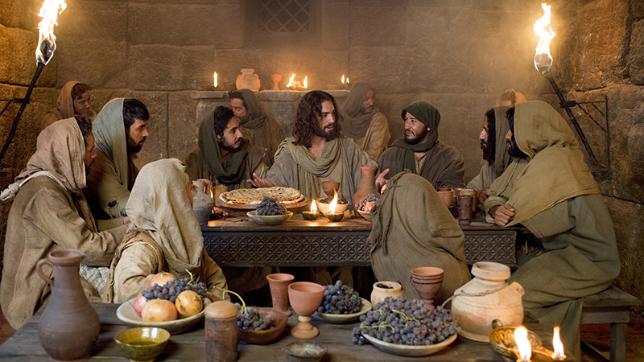
Dine with Me
Lord’s Supper – Judgment or Blessing?
Discerning the Real (Noah, Jacob, Esau)

Slide 5
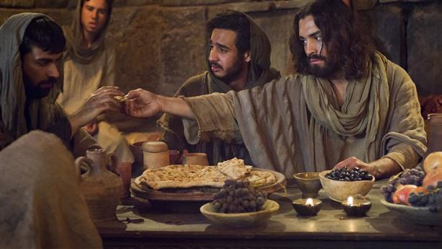
Beyond Food
Real sustenance
Community, culture, pleasures evermore

Slide 6
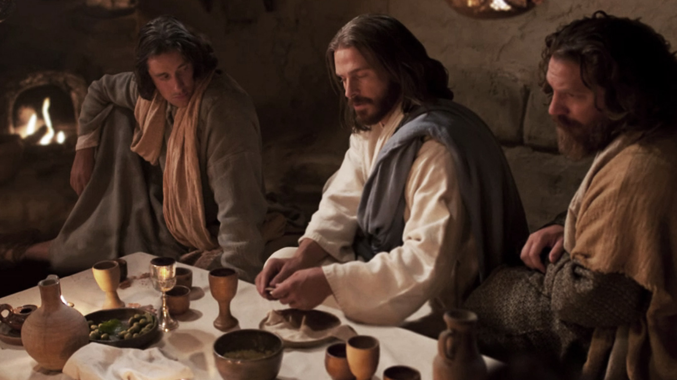
Rev 3:20 - If anyone hears my voice and opens the door, I will come in and eat with that person, and they with me.
Psalm 16:11- You make known to me the path of life; in your presence there is fullness of joy; at your right hand are pleasures forevermore.

