Slide 1
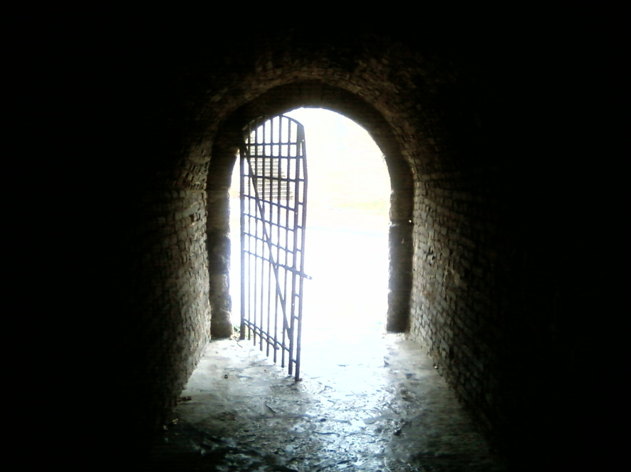
The God that Has Defeated Death!

Slide 2
Acts 2:22-24

Slide 3
John 11:21-26, 38-44

Slide 4
1 Corinthians 15:50-58

Slide 5
Matthew 22:23-33

Slide 6
The God we worship is the God who defeated death!

Slide 7
Luke 16:19-31

Slide 8
Revelation 20:11-15

Slide 9
Romans 3:21-26

Slide 10
John 3:35-36

Slide 11
1 Corinthians 15:12-22

Slide 12
1 Thessalonians 4:13-18

